Slide 1

Robotic Process Automation using UiPath
Topic 3- Activity Recording, UI Automation in StudioX
HITESH KUMAR SHARMA
Technical Instructor & Consultant

Slide 2

Introduction to RPA
StudioX Citizen Developer Journey and Working with StudioX
Activity Recording, UI Automation in StudioX
Decisions, Iterations, and Scenarios in StudioX
File, Folder Automation in StudioX: Microsoft Excel Automation
Email & SAP Automation in StudioX
Handle Errors in StudioX
COURSE OBJECTIVES

Slide 3
3. Activity Recording, UI Automation in StudioX
Introduction to UI automation
Recording UI interactions
The UI automation activities
Extracting data from an application

Slide 4
INTRODUCTION TO UI AUTOMATION
A user interface (or UI) is a point of interaction between computers and human users. With its help, humans can communicate with computers and other digital systems, be it applications or a webpage.
StudioX offers a dedicated activity pack for UI automation: App & Web Automation. Moreover, you can also make use of a variety of tools that we'll cover in the next lessons, one by one, including the activity pack: the Recorder, the Object Repository, the UI Activities, and the Table Extraction tool.

Slide 5
INTRODUCTION TO UI AUTOMATION (Contd..)
Input activities
The input activities send information (or input) to UI elements we wish to interact with. A few examples: Click, Type Into, Check/Uncheck, Keyboard Shortcuts.
Output activities
This type of activity retrieves information from a UI, in various forms: text, structured data or images.
A few examples: Get Text, Extract Table Data, Get URL.
Synchronizing activities
The synchronizing activities tell the robot when to execute an action, based on certain triggers. This can come in very handy when the UI changes or needs time to change during an automation.
A few examples: Wait for Download, Check App State.

Slide 6
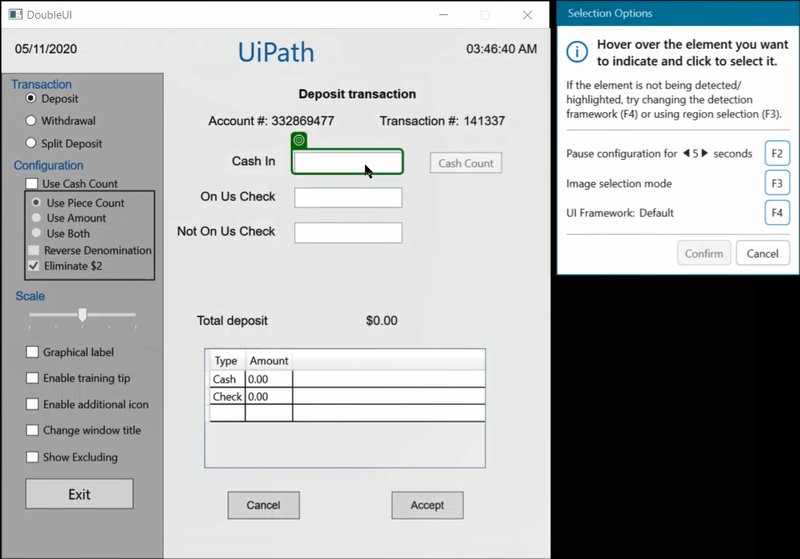
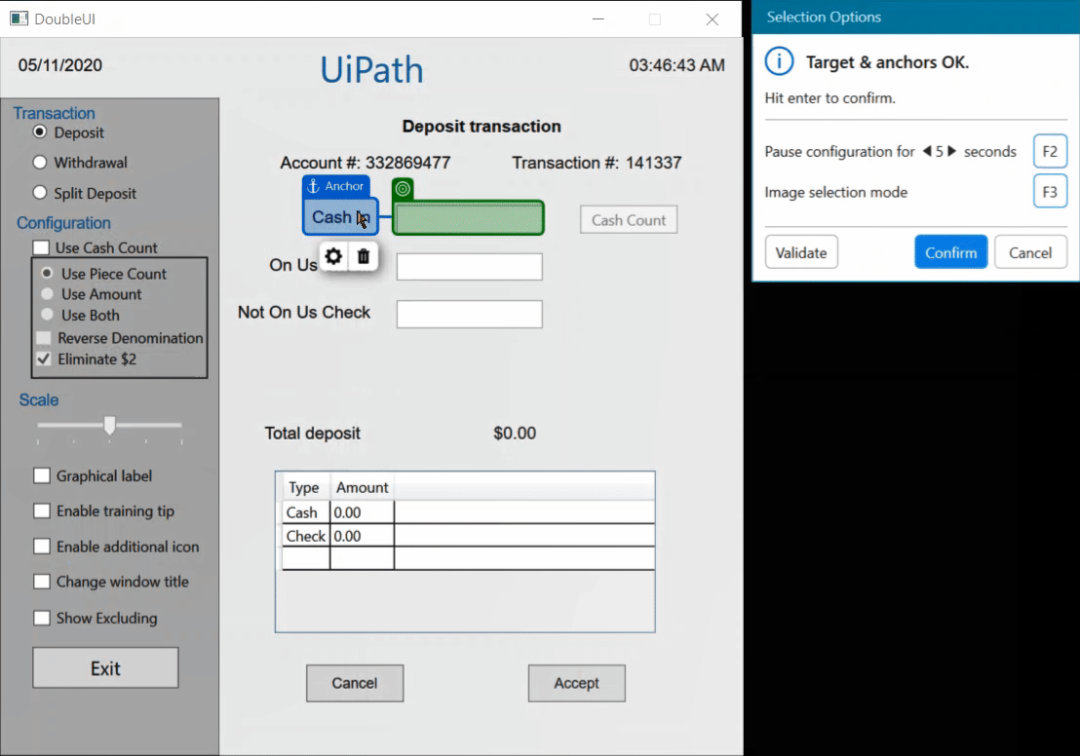
INTRODUCTION TO UI AUTOMATION (Contd..)
One of the most important aspects you need to know when it comes to UI automation is targeting. This can be done through targets and anchors. With their help, we indicate the target applications or elements on the screen with which we want the automation to interact. These elements are called targets and they can be fixed or dynamic. Anchors are fixed elements near targets, with which the automation can identify unique targets.

Slide 7
RECORDING UI AUTOMATION
With the help of the Recorder, we can capture a set of actions on screen when working with an application. The tool will automatically translate them into StudioX activities, for faster development. We can also configure the activities directly while using the Recorder.

Slide 8
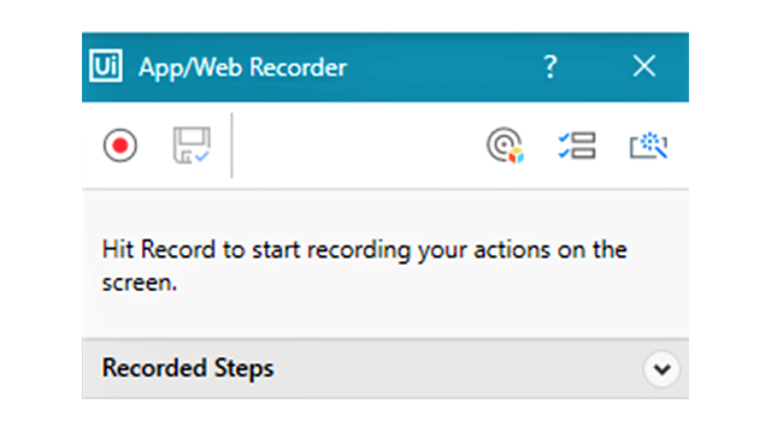
RECORDING UI AUTOMATION (Using Recorder)

Slide 9
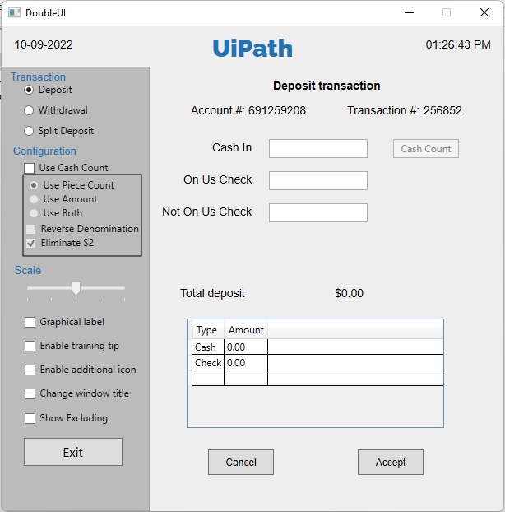
RECORDING UI AUTOMATION (Demo Application)

Slide 10
RECORDING UI AUTOMATION (Hand-On)
Let's pay a visit to Jude, the Financial Clerk who needs our help with building an automation. A weekly task of theirs is to get the transaction numbers for transactions documented in a spreadsheet. In building the automation, we'll use the spreadsheet provided below.
To perform their task, they use the Double UI App, where they input the information from the spreadsheet. The application generates the numbers, which then Jude must retrieve to the same spreadsheet, in a dedicated column.
In this lesson, you'll record the steps Jude performs for this task with the help of the Recorder, exploring the features of the tool.
In developing the automation you'll use the following input files, websites, and applications:
The Double UI App - this is the dummy bank teller app we'll be using to get the transaction numbers.
UI Automation - Input File - this is the spreadsheet we'll be working with, containing information about the transactions and needing to be filled with the transactions' numbers.

Slide 11
THE UI AUTOMATION ACTIVITIES
You can find the UI automation activities in the Activity panel in StudioX, under the App/Web Automation category. The specific resource, as mentioned before, is Use Application/Browser, which will indicate to the robot which UI is the object of the automation project.
Hardware Events
SendWindowMessages
Simulate

Slide 12
THE UI AUTOMATION ACTIVITIES (Hands-on)
In this one, we added a twist. Instead of the Double UI App, we'll use the UI Demo one, very similar to what you are used to. The difference is that the UI Demo requires authentication. So, in this demo, you'll also learn how to automate a login process.
In developing the automation you'll use the following input files, websites, and applications:
The UI Demo App - this is the dummy bank teller app we'll be using to get the transaction numbers.
UI Automation - Input File - this is the spreadsheet we'll be working with, containing information about the transactions and needing to be filled with the transactions' numbers.

Slide 13
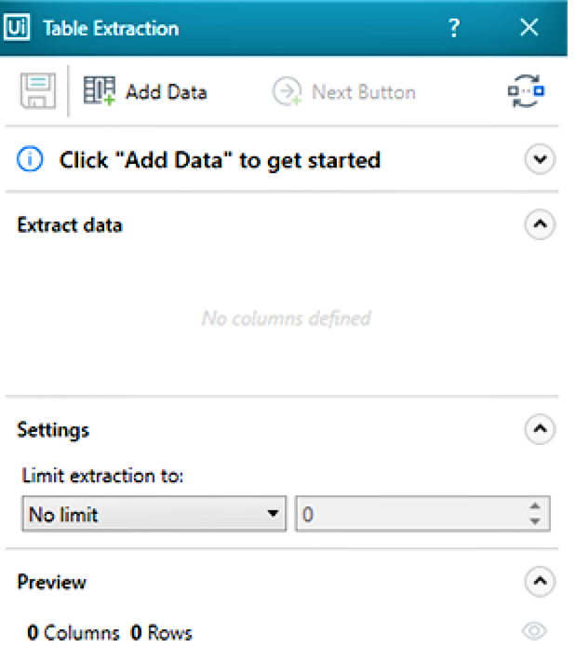
EXTRACTING DATA FROM AN APPLICATION
Table Extraction refers to data scraping. This means that StudioX will recognize structured data already found in a table in the target application or data that has a pattern. Upon recognizing the target information, it will be separated from the rest of the UI components and then saved.
Among the UI automation activities, we can find the Extract Table Data activity, which will launch the Table Extraction wizard. The wizard can also be activated from the Ribbon Menu, similarly to the Recorder tool. After the extraction, the information can be stored in a variable or transferred to a spreadsheet, including the possibility of a .csv file.

Slide 14
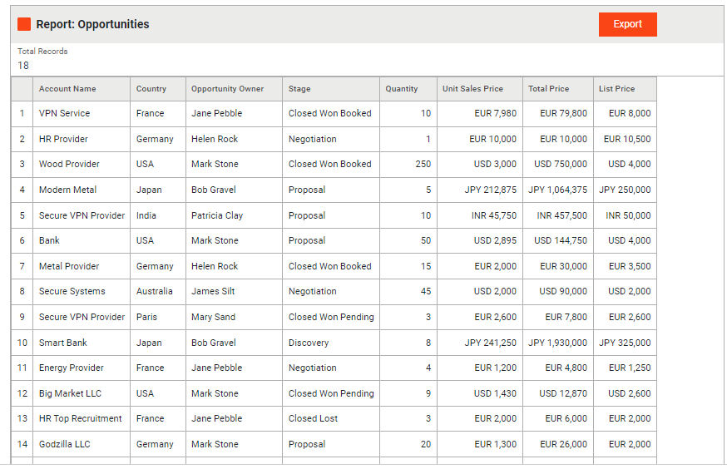
EXTRACTING DATA FROM AN APPLICATION (Hands-on)
In the following demo, we'll help out Jayden with the generation of a report. They work as a Sales Representative and the task for the day is to create a Sales Opportunities report.
The raw data is already available at rpasamples.com/opportunities in the form of a table, but they need to manipulate it further in an Excel file. Instead of copying and pasting each element separately, we'll show Jayden how they can prep their analysis in no time, with the help of the table extraction tool!

Slide 15
TOPIC 3
END
THANK YOU

